Slide 1
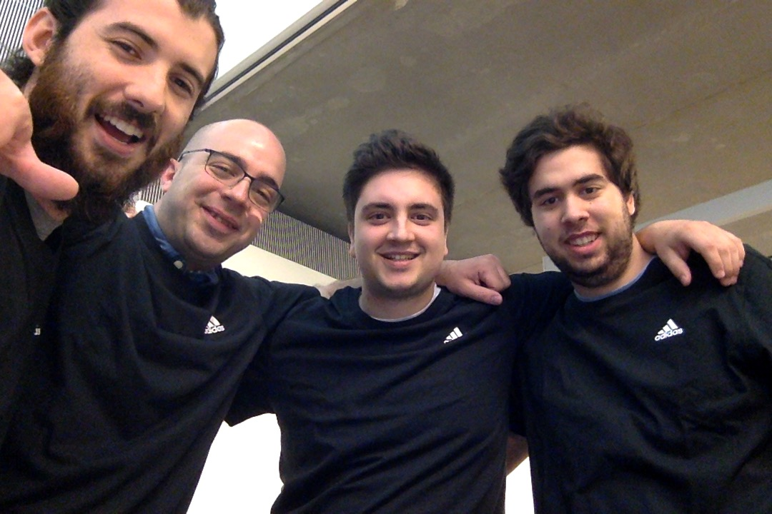




<NoBody>
TEAM PICTURE
Adrian Naranjo
Carlos Rodriguez
Jose Mir
Sergio Redondo
<STANDAPP>
Adobe XD CC
Maching Learning
Node + Express
TECHNOLOGIES
IOS/SWIFT
IBM SPSS
PM2
Google Firebase
Regression-js
AWS(EC2)

